Slide 1
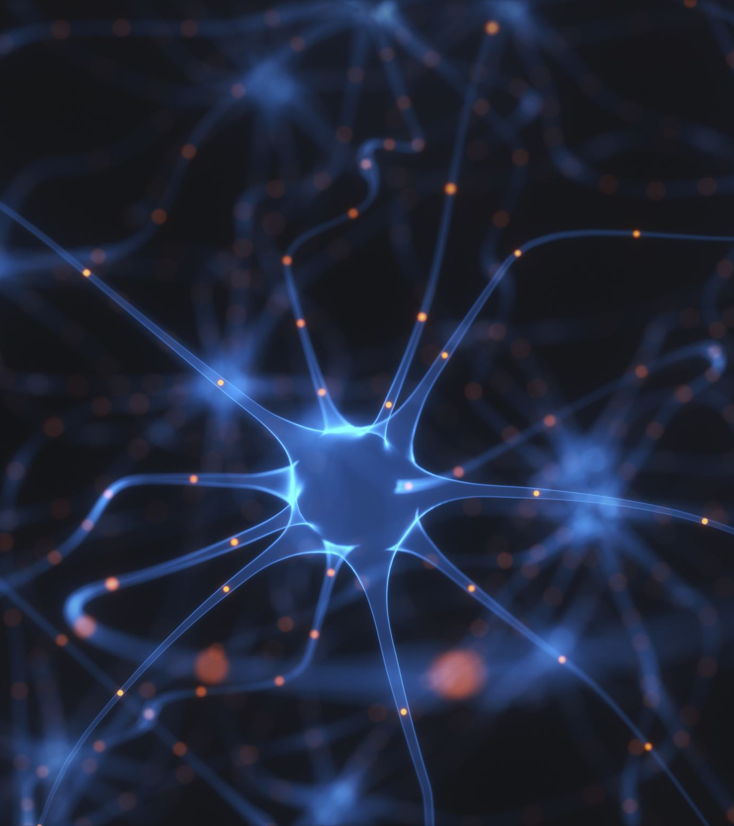
Neural Network Models for Object Recognition
Convolutional Neural Networks with CIFAR-10 Dataset
Notes:
Slide 1 : Title
This presentation is on the role of neural networks in object recognition. Specifically, in the application of Convolutional Neural Networks (CNNs) to the CIFAR-10 dataset.

Slide 2
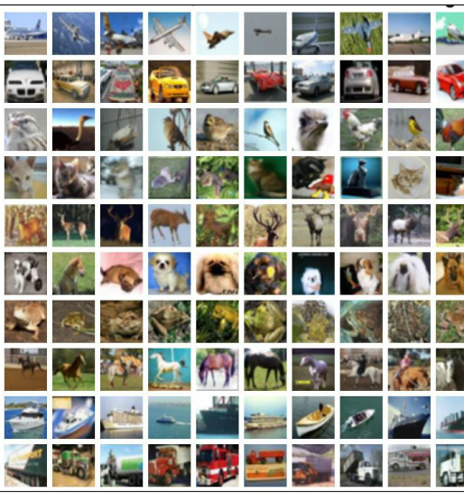
CIFAR-10 DATASET OVERVIEW
Collected by Alex Krizhevsky, Vinod Nair, and Geoffrey Hinton in 2009.
60,000 images.
32 x 32 pixels.
3 ‘RGB’ colours.
10 classes: 'airplane', 'automobile', 'bird', 'cat', 'deer’, 'dog', 'frog', 'horse', 'ship', 'truck’.
(Krizhevsky, 2009)
Notes:
Slide 2: Dataset Overview
Before going any further, we need to understand the dataset. CIFAR-10 was collected by Alex Krizhevsky, Vinod Nair, and Geoffrey Hinton in 2009.
It is named ‘CIFAR-10’ after the Canadian Institute for Advanced Research who funded the projected.
It consists 60,000 images each 32 by 32 pixels in size. These images are represented in three channels – Red, Green, and Blue, making them a rich source for training convolutional neural networks.
They are grouped into 10 classes, each representing different objects such as airplanes, automobiles, birds, cats, deer, dogs, frogs, horses, ships, and trucks.
With each of these classes containing 6000 images.

Slide 3
Data Preprocessing

Slide 4

Data Splitting
Data split into training, test, and validation datasets.
40,000 images in training set : Used to train the model, allowing it to learn from a variety of examples and features.
10,000 images in validation set : Used to fine-tune the model parameters and prevent overfitting. Act as a check during training to adjust learning rates or any hyperparameters to optimize performance .
10,000 images in test set : Provides an unbiased evaluation of the final model. Represents the real-world application and effectiveness of the model.

Slide 5
Normalisation
Purpose: Uniform Scale, Improving the neural networks’s convergence and stability during training.
Method: Divided each pixel by 255 to scale from [0,255] to [0,1].
Impact: Reduces model sensitivity to the scale of features and speeds up learning.

Slide 6
One-hot Encoding
Purpose: Transform Categorical class labels into a binary matrix.
Method: Converted class labels into a binary vector with all zeros except for a 1 at the index of a class label.
Impact: Allows the use of categorical cross-entropy loss during training, which is effective for multi-class classification problems.

Slide 7
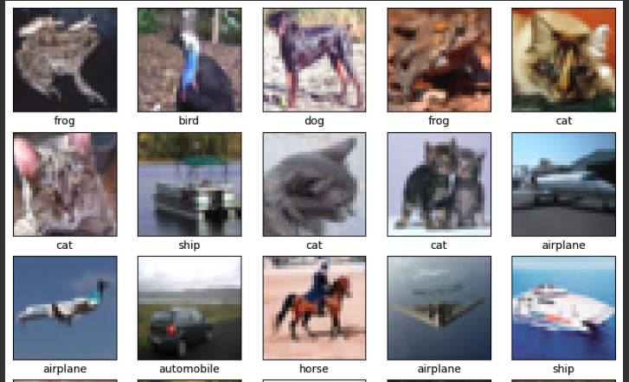
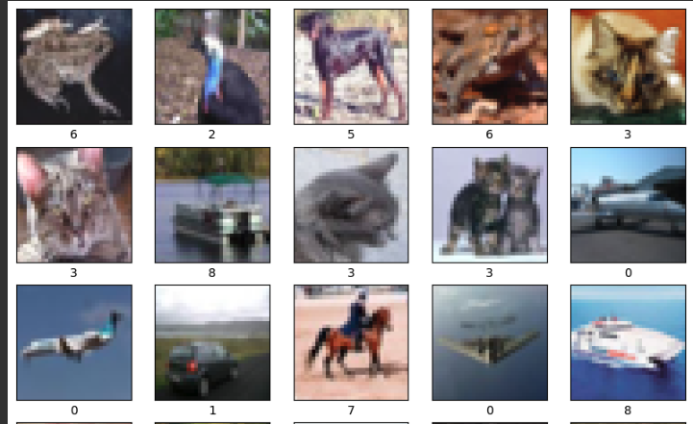
One-hot encoding
The Different Classes Before and After One Hot Encoding

Slide 8
Model Training

Slide 9
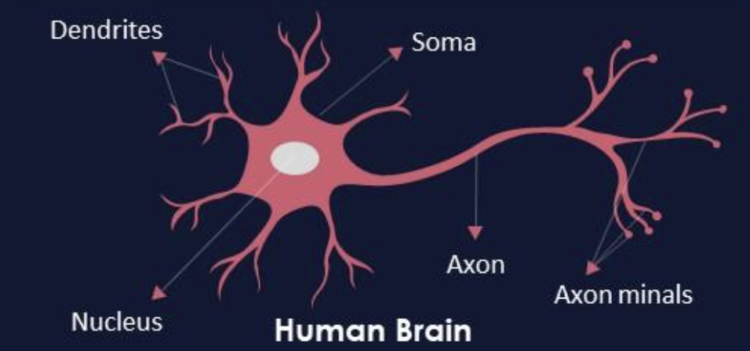
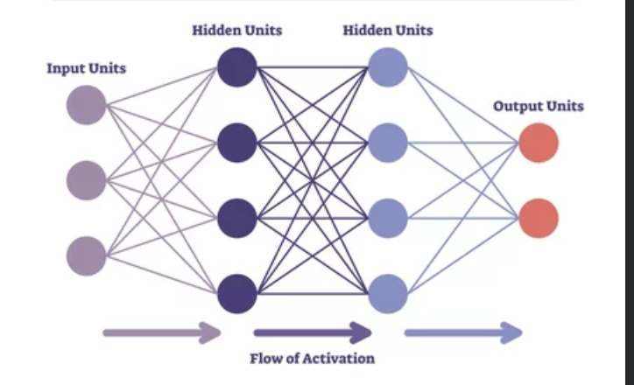
Artificial Neural Networks
Designed to simulate the human brain.
Receives an input and transform it through a series of hidden layers.
Each hidden layer is made up of a set of neurons,
Each neuron is fully connected to the neurons in the previous layer.
Neurons in a single layer function independently and do not share any connections.
The last fully connected layer, “output layer” represents the class scores.
Types of ANNs : Feedforward Neural Networks, Recurrent Neural Networks, Convolutional Neural Networks, etc.

Slide 10
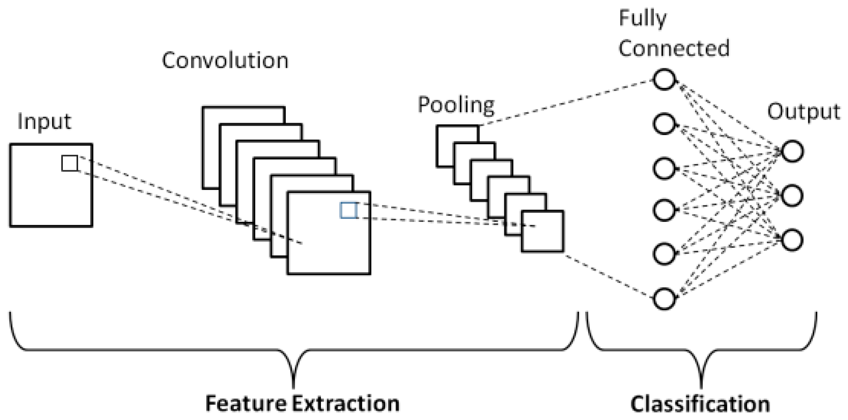
Convolution Neural Networks
CNNs are engineered to automatically and adaptively learn spatial hierarchies of features, from low-level details to high-level patterns.
CNN layers:
Input - Images
Convolution – Applies filters to create feature maps.
Rectified Linear Unit (ReLu) – Increase the image’s non-linearlity. Improves feature extraction.
Pooling – Reduces the spatial size of the feature maps. Example Max Pooling
Fully connected – Takes in an input volume and output an N-dimensional vector where N is the number of classes being scored in the classifier.
Output layer
(Badea et al., 2018)

Slide 11
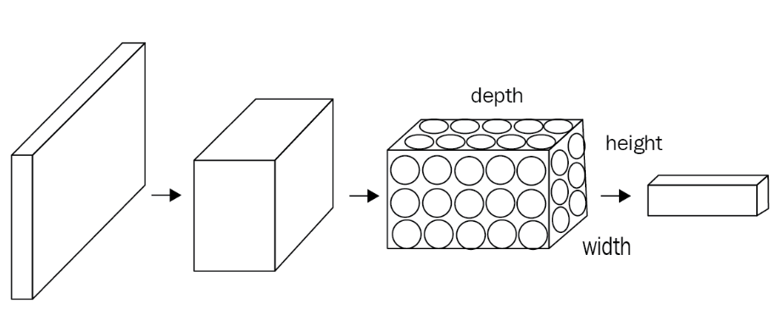
Why CNNs for CIFAR-10 dataset?
Preservation of Spatial hierarchy.
Parameter Sharing and Efficiency.
Depth Utilisation and Efficiency.
Adaptability to image Data.
(Sewak et al., 2018)

Slide 12
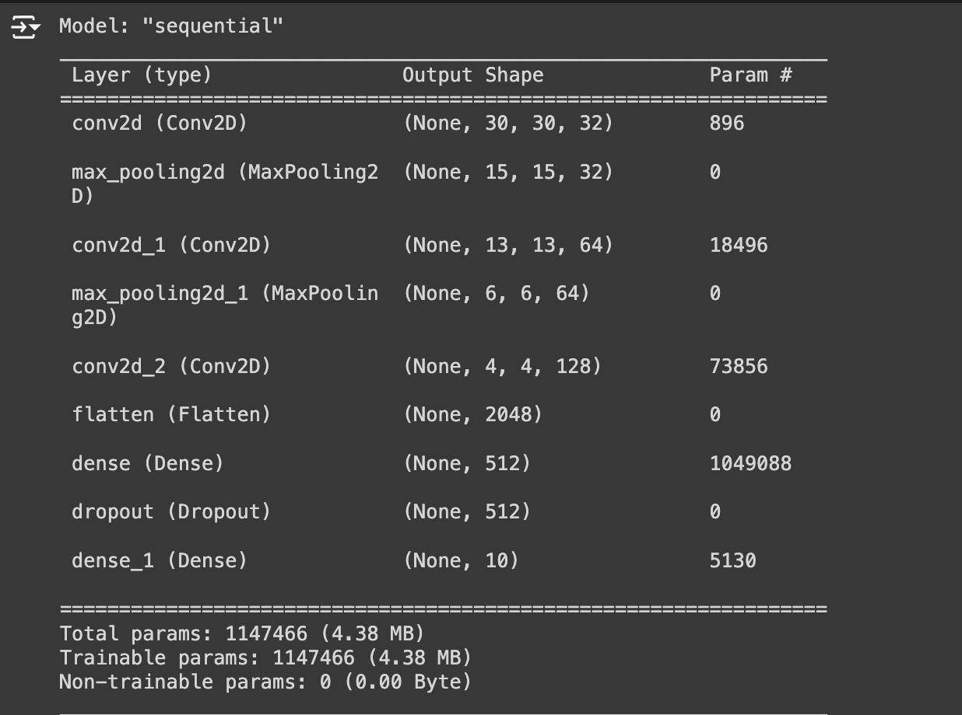
CIFAR-10 CNN Model-1 Architecture
Initial Layers: Conv2D with 32 filters of size 3x3 and max pooling layer MaxPooling2D.
Increasing Complexity: Additional convolutional layers with increasing numbers of filters (64 and 128. Each followed by a max pooling layer.
Feature Flattening: A flatten layer to convert the 2D feature maps into a 1D feature vector necessary for the next fully connected layers.
Fully Connected Layers: A dense layer with 512 neurons to process the flattened features, integrated with a dropout layer at 50% rate
Output Layer: A dense layer with 10 neurons corresponding to the 10 classes of CIFAR-10, using softmax activation to output class probabilities.
Total Parameters = 1,147,466

Slide 13
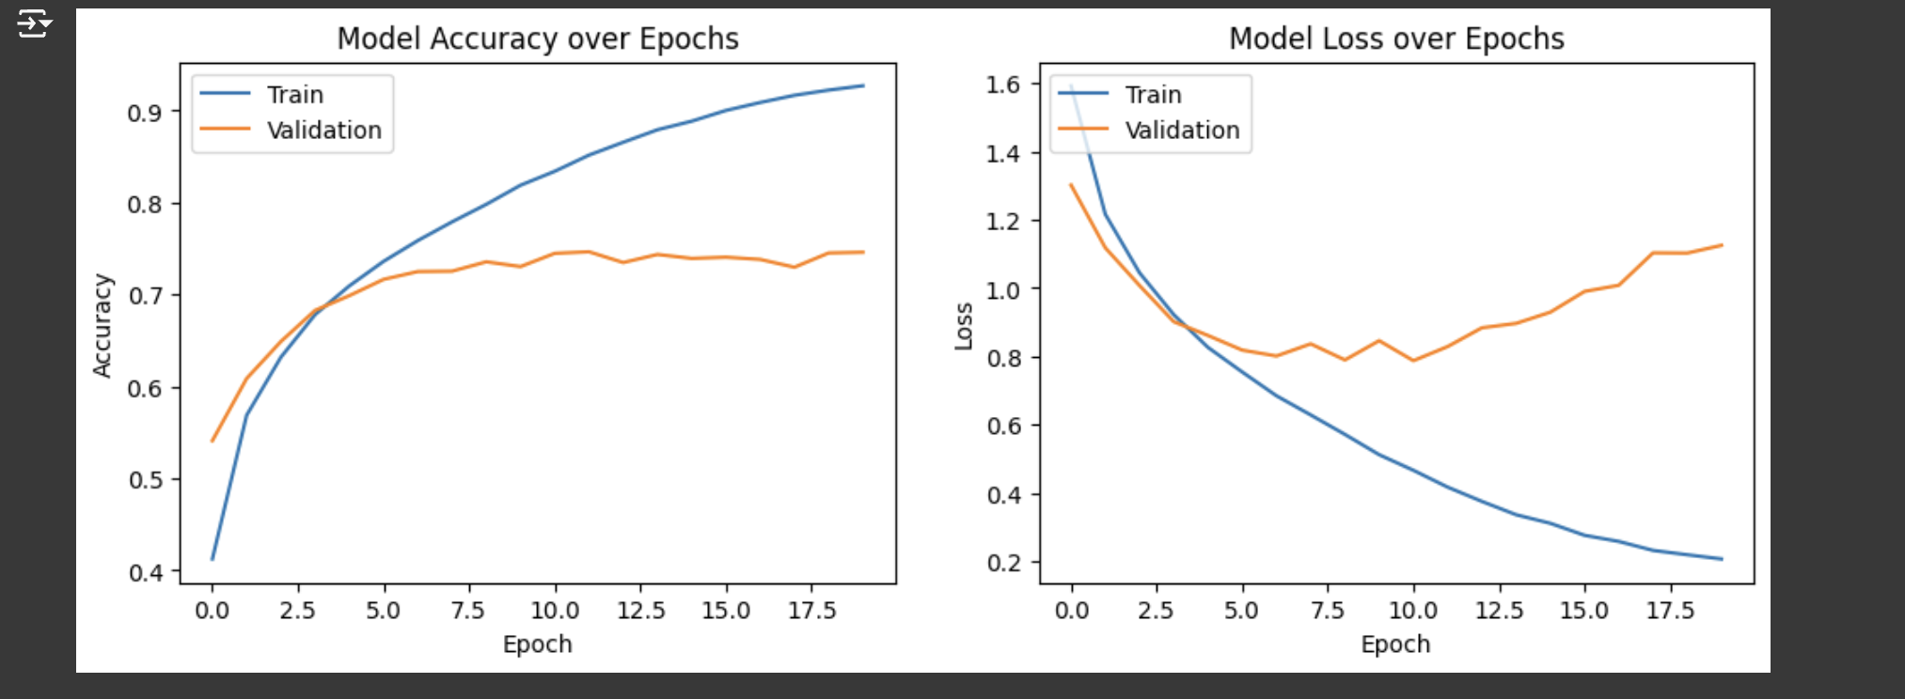
Model 1 Performance
Epochs = 20
Batch size = 64
Model-1 is overfitting
The model is learning from the noise rather than generalizing it.

Slide 14
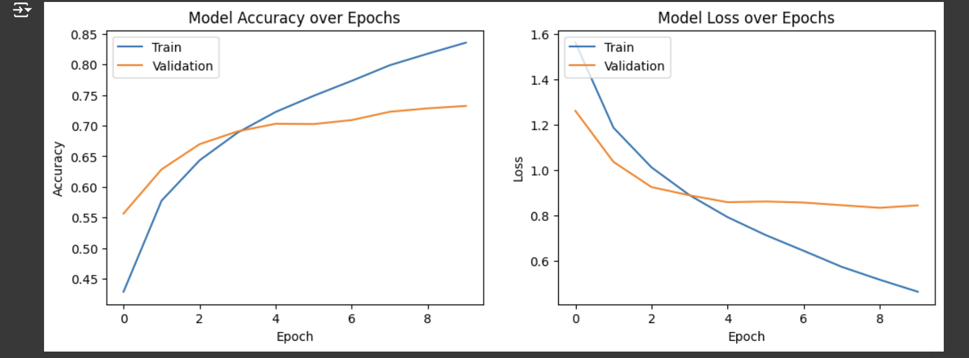
Tuning Model 1
Epochs = 10
Batch size = 64
Model still overfitting
Huge gap between training and validation accuracy.
No change in the model’s performance.

Slide 15
Addressing Overfitting

Slide 16
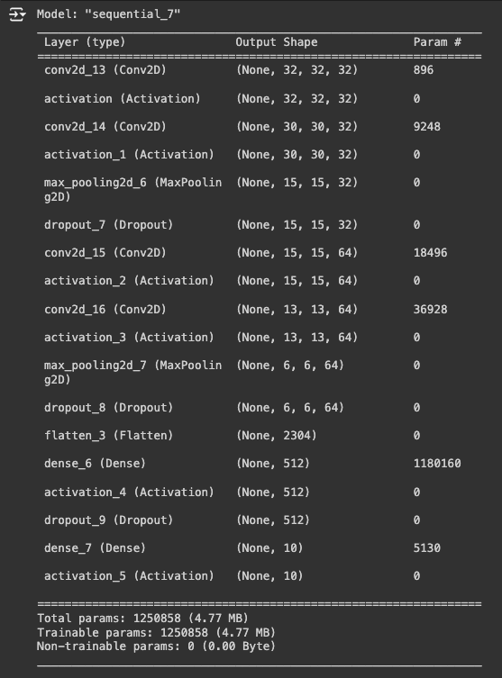
Model 2 Architecture
Increased the model’s complexity.
100 epochs.
Dropout layers.
RMSprop optimizer.
Learning Rate Schedule
Exponential decay schedule starting at 0.001.
Decaying every 100,000 steps.
Decay rate of 0.96.
Staircase function.
Categorical crossentropy loss function.

Slide 17
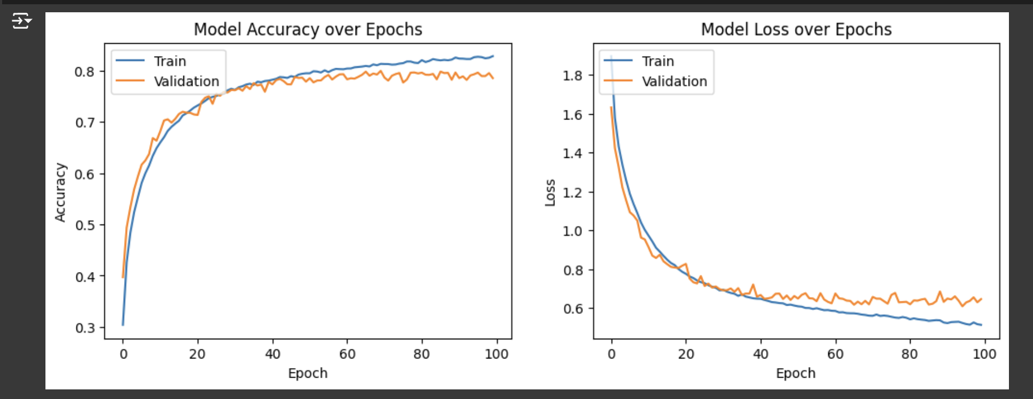
Model 2 Performance
Accuracy Over Epochs:
Training Accuracy: Plateaus at around 82%.
Validation Accuracy: Plateaus around 70-72%. Gap between training and validation accuracy, suggesting some overfitting but is not overly severe. The validation accuracy is reasonably stable, indicating the model is generalising, albeit not perfectly.
Loss Over Epochs:
Training Loss: Decreases smoothly and plateaus, which indicates good learning on the training set.
Validation Loss: Reduces significantly initially and then stabilises. Noticeable gap.
Training Accuracy = 82%
Validation Accuracy = 78%
Training Loss = 0.51
Validation Loss = 0.65

Slide 18
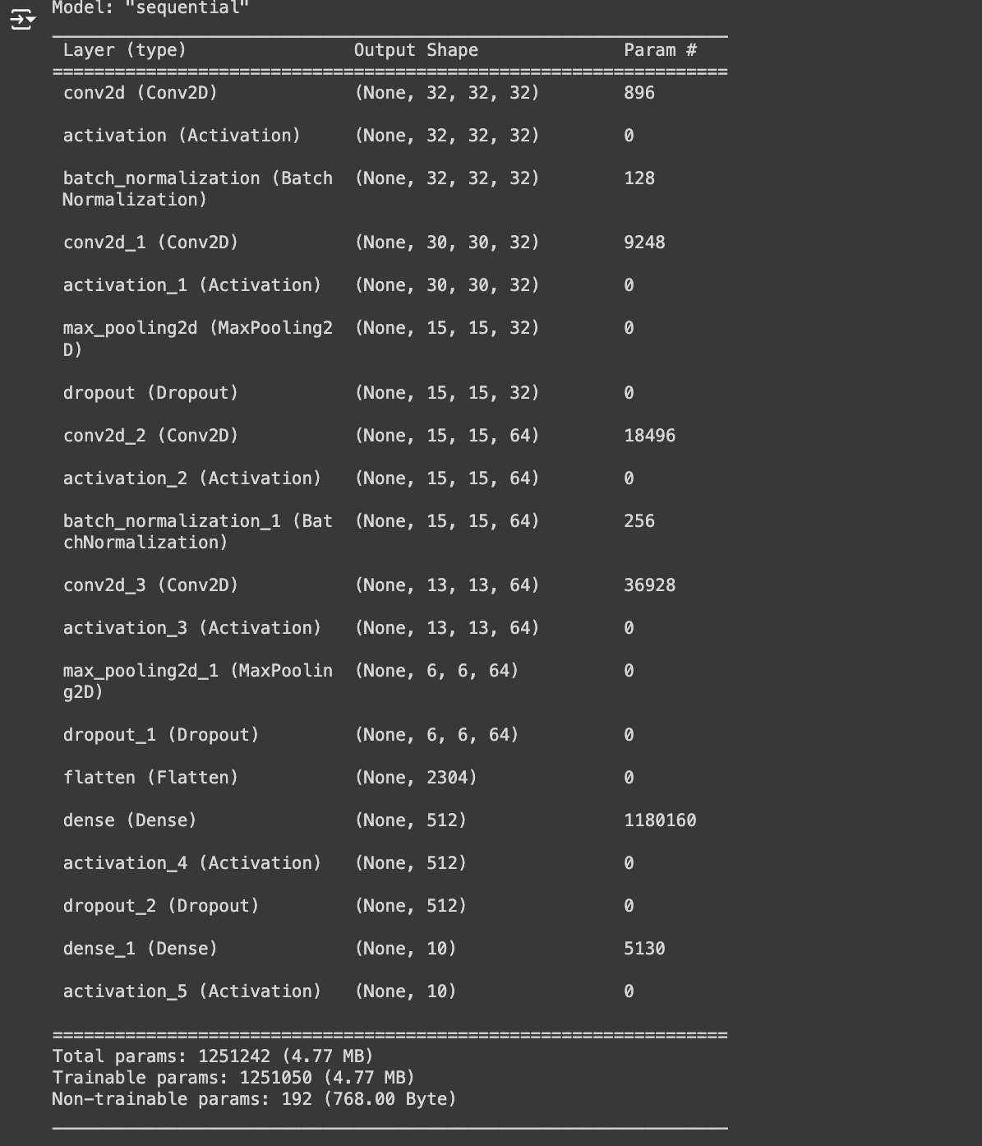
Improving Model 2: Mitigation Overfitting
Batch Normalisation.
Data Augmentation.
Early Stopping.
Optimizer : adam.
Dropout 0.25 to 0.3

Slide 19
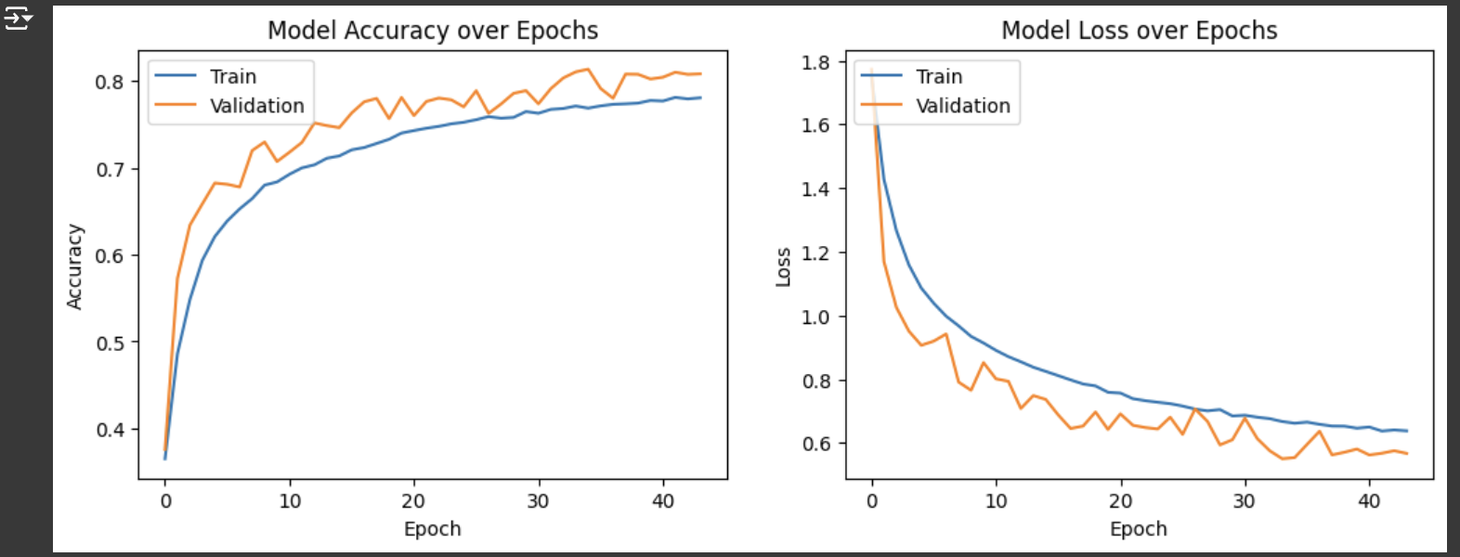
Model 3 Performance
Early Stopping Efficiency: Initially planned for 100 epochs, early stopping triggered a halt at 44 epochs due to no further improvement in the validation loss, demonstrating the model's efficiency in learning.
Stability and Convergence: Exhibited robust stability and effective convergence, indicating a well-tuned learning process.
Overfitting Management: Superior in managing overfitting compared to previous models, particularly Model 2, as evidenced by closer training and validation metrics.
Enhanced Generalisation: Achieved higher validation accuracy and lower validation loss, indicating stronger generalization to unseen data.
Training Accuracy = 78%
Validation Accuracy = 80%
Training Loss = 0.64
Validation Loss = 0.57

Slide 20
Model Evaluation

Slide 21
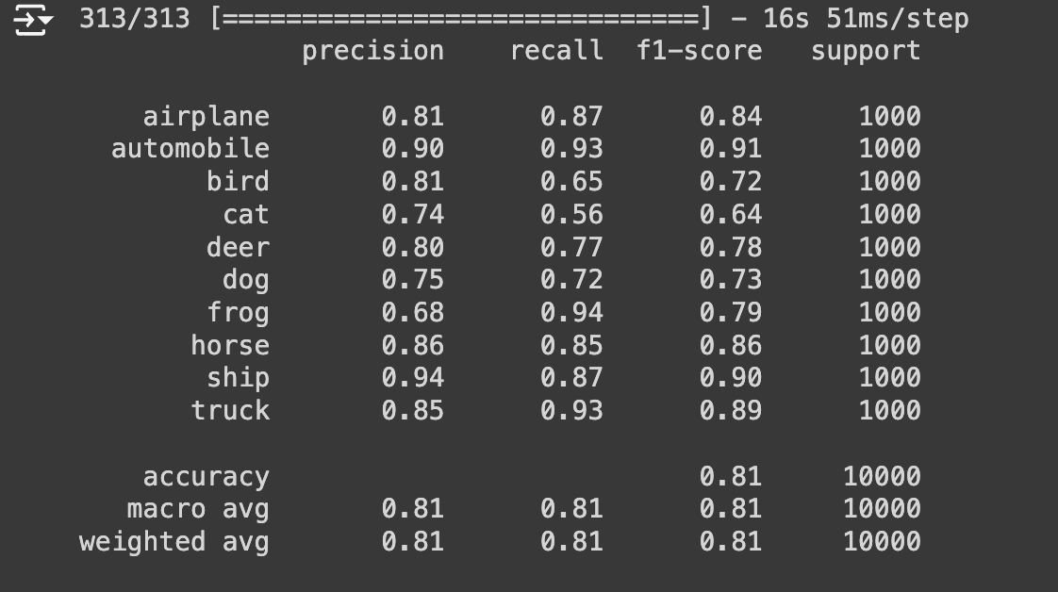
Classification Report
Best performing classes – automobile and ship.
Challenges – cat.
Good specificity but inconsistent sensitivity.

Slide 22
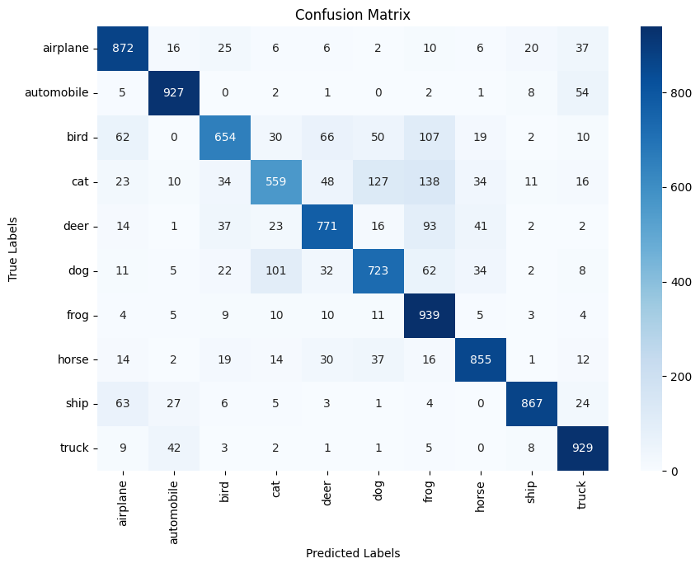
Confusion Matrix
High true possitive rates for some like Frog, Automobile, Airplane,etc.
Misclassifications:
Cats misclassified as Frogs
Cats misclassified as Dogs
Problematic classes:
Cats
High Confusion rate with classes with similar features – Cats and dogs, truck and automobile.
Model’s strengths
Specificity in certain classes like Frog and Automobile.

Slide 23
Recommendation and Conclusion

Slide 24
Recommendation
Enhanced feature engineering.
Data Augmentation for problematic classes like Cat.
More Algorithm Tuning.
Advanced techniques like CNNs with deeper layers to capture subtler distinctions between classes.
(Ajiboye et al., 2015)

Slide 25
Conclusion
Effectiveness of CNNs in image recognition.
Data Volume and Diversity.
Challenges in training:
Overfitting.
Computational and time demands.
Applications to different domains like autonomous driving and Medical Image Computing.
(Sharma, 2023)

Slide 26
References
Ajiboye, A.R., Abdullah-Arshah, R., Qin, H., Isah-Kebbe, H. (2015) Evaluating the effect of dataset size on predictive model using supervised learning technique. International Journal of Software Engineering & Computer Sciences 1: 75–84. DOI: http://dx.doi.org/10.15282/ijsecs.1.2015.6.0006
Badea, C.T., Holbrook, M., Clark, D.P. (2018) 'Multi-energy CT decomposition using convolutional neural networks', Medical Imaging 2018: Physics of Medical Imaging. Houston, United State, 10-15 February. SPIE.
Krizhevsky, A. (2009) CIFAR-10 and CIFAR-100 datasets Available from: https://www.cs.toronto.edu/~kriz/cifar.html [Accessed 24 May 2024].
Sewak, M., Karim, M.R., Pujari, P. (2018). Practical Convolutional Neural Networks. Packt Publishing. Available from: https://learning.oreilly.com/library/view/practical-convolutional-neural/9781788392303/ [Accessed 24 May 2024].
Sharma, P., 2023. Applications of Convolutional Neural Networks(CNN). Analytics Vidhya. Available from: https://www.analyticsvidhya.com/blog/2021/10/applications-of-convolutional-neural-networkscnn/ [Accessed 27 May 2024].

